Slide 1

G2M Case Study
Virtual Internship
Vincent Machoka Obiri
08-Jan-2022

Slide 2
Agenda
Executive Summary
Problem Statement
Approach
Data Exploration
EDA
EDA Summary/Recommendations
Machine Learning
Appendix

Slide 3
Executive Summary
Investing in any company necessitates a thoughtful, thorough and transparent business analysis to make an informed decision. XYZ, a private firm in the US, wants to invest in a Cab Industry that has seen exponential growth for the last few years. Particularly, the firm is interested in one of the two Cab companies- Yellow Cab or Pink Cab.
Analysis such as Exploratory Data Analysis (EDA), feature engineering, statistics, and plots were performed on various cases on historical data from 2016 through 2018 for two companies.
Based on results from these analysis, it is my recommendation to XYZ firm to invest in Yellow Cab company. Every analysis performed showed Yellow Cab company always performed better than Pink Cab.
To further assist XYZ, a machine learning model was developed for Yellow Cab Company from 2016 data. The model prediction was validated using first quarter of 2017 data, which Model had never seen. The prediction accuracy range between 0.4% to 1.7%, which suggests a good model that can be deployed in production.

Slide 4
Problem Statement
XYZ, a private firm in US needs to make a data driven decision to invest in a Cab company based on available datasets from two companies- Yellow Cab and Pink Cab.
The objective is to pick one company over another based on various data analysis.

Slide 5
Approach
Historical Data collection from 2016 and 2018.
Weather Data collection relative to Historical Data collection from climate.gov.
Final Dataset created by combining Historical Data and Weather Data.
Various Exploratory Data Analysis performed.
Analyzed which Cab company performed better profit-wise.
Built a machine learning model to help XYZ firm predict future profits.

Slide 6
Data Exploration
Timeframe of the data: 2016-01-31 to 2018-12-31
Total data points : 359,392
Assumptions:
Profit of rides are calculated keeping other factors constant and only
Price_Charged and Cost_of_Trip features used to calculate profit.
Outliers are present in Price_Charged feature but due to
unavailability of trip duration details ,we are not treating this as outlier.
Users feature of city dataset is treated as number of cab users in the city.
we have assumed that this can be other cab users as well(including Yellow and
Pink cab)
Cab_Data.csv
Customer_ID.csv
Transaction_ID.csv
City.csv
Temp.csv
Master Dataset

Slide 7
Exploratory Data Analysis
Five datasets Cab Data, Customer ID Data, Transaction ID Data, City Data and Temp_2016_2018 data were combined.
Total of 16 features were present in final data set, and with 359,392 observations.
One important feature target Profit was derived from Price Charged and Cost of Trip.
All the Exploratory Data Analysis was performed with feature target Profit in mind.

Slide 8
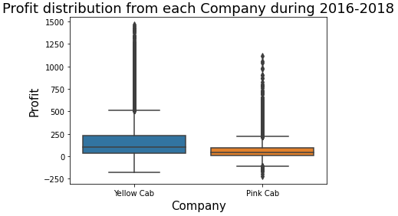
Box Plot Profit Distribution
From the plot to the left, Yellow Cab did bring in more profit than Yellow.
Median for Yellow Cab is 102.0 and for Pink Cab it is 41.5.
102
41.5
Note: Machine learning model was fed all the above data including outliers that are seen here. The model however did not have any major issue, which tells these may be valid data!

Slide 9
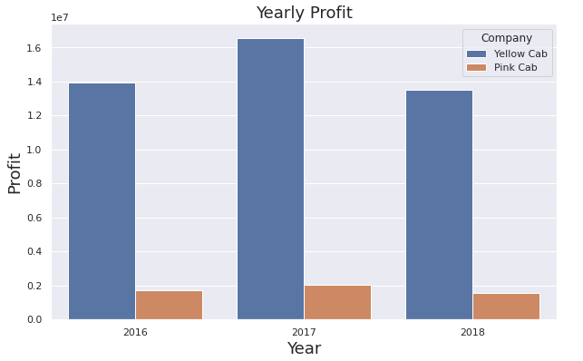
Yearly Profit
Looking at Yearly Profit also, Yellow Cab brought in relatively higher profits than Pink Cab.
In 2016, Yellow Cab brought 14 million whereas Pink Cab brough in only 1.7 million, and the same trend for 2017 and 2018 from the plot to the left.
16.5 M
14 M
13.5 M
1.7 M
2 M
1.5 M

Slide 10
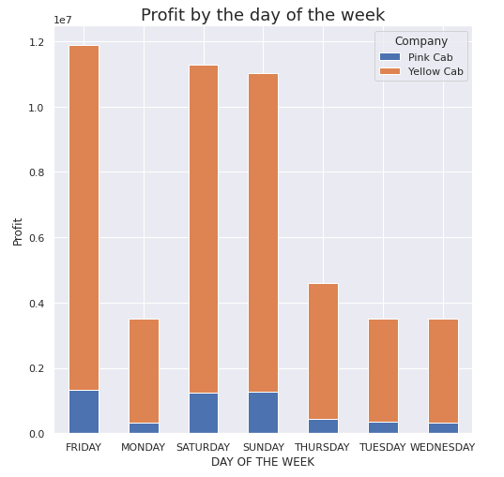
Profit by the day of the week
10.5 M
Analyzing Profit by the day of the week during 2016-2018 also suggests Yellow Cab performed much better than Pink Cab.
On Friday, Yellow Cab generated 10.5 million profit compared to 1.3M by Pink Cab, and similar trends follow for Saturday and Sunday.
10.0 M
9.7 M
1.3 M
1.3 M
1.28 M

Slide 11
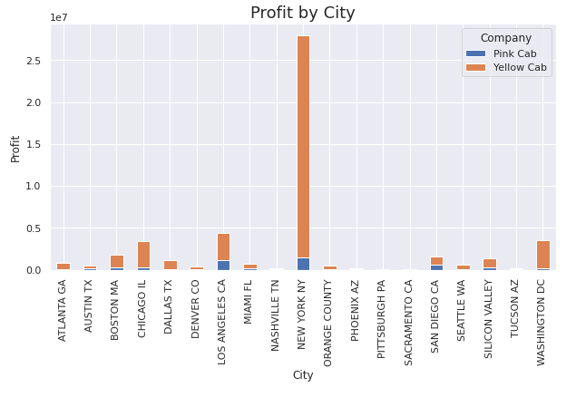
Profit by City for each Company
In every city across, Yellow Cab performed better than Pink Cab.
New York has more business for both companies. Yellow Cab brought in 2.8 M profit here compared to 1.5 M for Pink Cab approx.
2.8 M
1.5 M

Slide 12
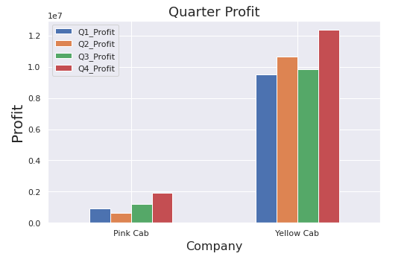
Quarterly Profit 2016-2018
Quarter data at each year (2016 thru 2018) calculated and combined.
Yellow Cab company clearly outperforms Pink Cab in all quarters.
Ex: Yellow Cab in Q4 brought in 12.3 million dollars compared to just 1.94 million by Pink Cab.
12.3 M
10.6 M
9.48 M
9.8 M
1.94 M
0.93 M
0.65 M
1.18 M

Slide 13
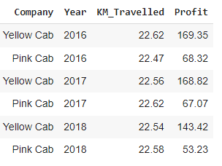
KM Travelled average vs Profit Average
Average Profit per average KM Travelled was also higher for Yellow Cab than Pink, as shown by a table to the left in each year. Yellow Cab is a clear choice again!

Slide 14
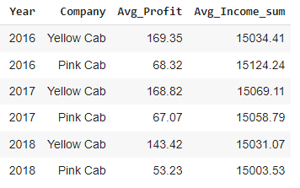
Average Income vs Profit Average
Average Profit per average income was also higher for Yellow Cab than Pink, as shown by a table to the left in each year. Yellow Cab is a clear choice again!

Slide 15
EDA Summary/Recommendations
Data analysis such as overall Profit distribution, Yearly Profit, Profit at the day of the week, Profit by City, Quarterly Profit, KM Travelled average against Profit Average and Average Income against Profit Average all show Yellow Cab company is far more profitable than Pink Cab!
Based on this assessment, I recommend XYZ firm to invest in Yellow Cab.
To assist XYZ firm further, Machine learning model was developed for Yellow Cab data, which is presented in next slides.

Slide 16
Machine Learning (ML) Model-Feature selection
2016 Yellow Cab data that are pre-processed prior to EDA.
Feature selection performed based on Pearson correlation since we are predicting numerical variable from numerical features.
Number of features considered based on Pearson correlation value closer to 0.5 or higher. Initially, features selected are KM Travelled, Price Charged, Cost of Trip, Population and Users. Correlation table is presented as an Appendix.
Population and Users have a correlation factor of 0.92. Including Population has a feature in ML model actually made the model worse- hence dropped. More importantly profit is being generated by actual number of cab users.
The final features are: KM Travelled, Price Charged, Cost of Trip and Users, to predict target variable Profit.

Slide 17
ML Model Data Distribution
Training set: 80% of dataset
Test set: 20% of dataset
ML Framework used: Scikit-Learn, TensorFlow.
Scikit-learn used to split the data
TensorFlow used to actually build the ML model
Features: KM Travelled, Cost of Trip, Price Charged, Users
Target Variable: Profit

Slide 18
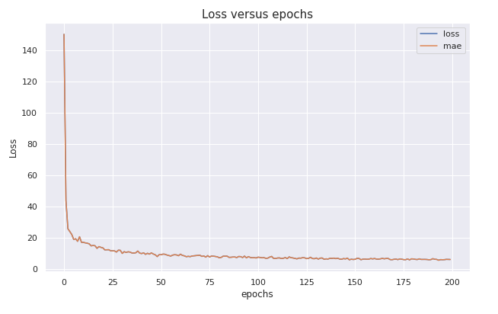
ML Model Loss(MAE) over iterations
Loss and MAE are the same for the model.
MAE starts to flattens after 125 epochs(iterations) and achieve a constant MAE after 175 iterations.

Slide 19
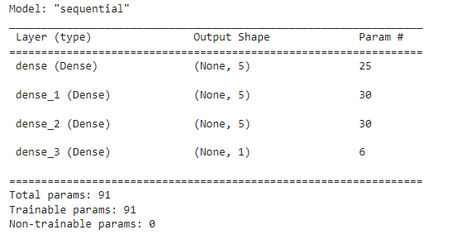
ML Model Structure
Sequential Deep Neuro Network (DNN) Linear Regression from TensorFlow utilized.
Model Creation:
3 Hidden Layers- each with 5 neurons with rectifier ReLU activation function.
1 layer is the output with 1 neuron since we are predicting one Profit value each time.
Model Compilation
Loss function of mean absolute error (MAE)- typical for linear regression
Optimizer: Adam optimizer with learning rate of 0.01031 for the best performance.
Metrics kept as MAE.
Model Fit
-80% training set, with epochs of 200.
Model test
-20% training set, resulted in MAE of 2.07

Slide 20
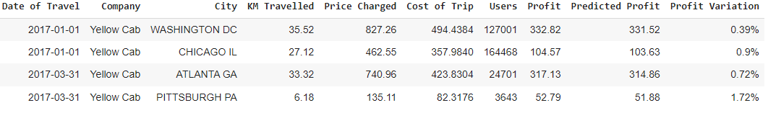
ML Model Validation
The table shows predicted profit from ML model next to real Profit data.
The profit variation as shown in the table ranges from 0.39% to 1.72% for these randomly picked data from Q1 2017 data, which suggest ML model is really good.
I recommend XYZ firm to start using this ML and optimize more if it chooses to.

Slide 21
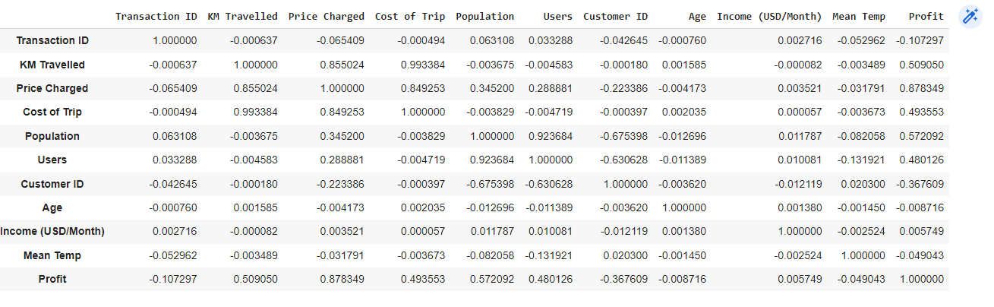
Appendix

Slide 22
Thank You

